Slide 1



XENA LaaS
Library as a Service
Standardizing Compute Execution Across GRID
Event-Driven
Serverless Control
Contract Execution

Slide 2




THE PROBLEM
Current State
RESULT
Library integrations require custom orchestration
Slow onboarding of
new capabilities
Multiple input formats and payload structures
Fragmented
execution models
Tight coupling between services and compute
Operational overhead — containers, routing logic
Increased
maintenance cost

Slide 3



THE OPPORTUNITY
From Integrations → Platform
01
02
03
One Standard
Execution Model
One
Data Contract
Zero Service-Specific
Orchestration
Libraries become plug-and-play capabilities

Slide 4

THE SHIFT
Before → After
BEFORE
AFTER — XENA LaaS
Service-driven execution
Contract-driven execution
Custom payload per use case
Single input model (Parquet + metadata)
Multiple ingestion paths
Event-driven orchestration
Tight coupling
Decoupled compute

Slide 5


ARCHITECTURE OVERVIEW
Three-Layer Model
1
Control Plane
Orchestration via Lambda + SQS
XENA
2
Data Plane
Shared storage contract
S3
3
Compute Plane
Execution of target libraries
GRID / XDE
Independent scaling · Clear responsibilities

Slide 6

THE CONTRACT
Core Innovation — Single Self-Contained Input
contract.json
Each job is a
single Parquet file
{
"jobId": "job-123",
"targetLibrary": "risk-factor",
Data → structured rows
"targetVersion": "1.2",
"clientPayload": "{...}"
Control → metadata (footer)
}
→ No branching logic in XENA
→ Fully generic across libraries

Slide 7
EVENT-DRIVEN FLOW
End-to-End Flow + Payload Enrichment
1
Input uploaded to S3
2
Event → SQS → XENALoader
3
XENALoader: reads, validates, enriches
4
GRIDConnector invokes GRID
PAYLOAD ENRICHMENT
• Input location
• Output paths
5
GRID executes library
6
Results written to S3
7
manifest.json signals completion
• Tracking metadata
• Control flags (reconciliation, retries)
XENA = contract transformer, not business logic processor

Slide 8
PAYLOAD STRUCTURE
Generic Execution Payload
execution-payload.json
Same structure
{
for all libraries
"jobId": "job-123",
"targetLibrary": "risk-factor",
"resolvedVersion": "1.2",
Fully extensible
"inputFile": "s3://xena-input/...",
without code changes
"resultsPath": "s3://xena-output/...",
"errorPath": "s3://xena-error/...",
"control": { "reconciliation": false },
Zero branching
"clientPayload": { "...": "..." }
in orchestration logic
}

Slide 9

STORAGE MODEL
S3 Bucket Architecture
INPUT BUCKET
OUTPUT BUCKET
ERROR BUCKET
s3://xena-input/{library}/{jobId}/input.parquet
s3://xena-output/{library}/{jobId}/
s3://xena-error/{library}/{jobId}/
├── input.parquet
├── _progress.json
├── error-details.json
├── manifest.json
├── results...
Clear separation
Predictable structure
Enables event filtering

Slide 10


OBSERVABILITY
Multi-Layer Monitoring
Operational Metrics
Event Analytics (GETAFE)
Lambda · SQS queues · Execution status
Kafka-based event tracking
Elasticsearch + Kibana dashboards
SIGNALS — Small structured events, not large data
Job Started
_progress.json →
real-time progress
manifest.json →
completion signal
High visibility with minimal overhead

Slide 11



SECURITY & GOVERNANCE
Secure by Design
IAM-Based Access Control
S3 Encryption (KMS)
Fine-grained identity policies enforced at every layer
All data encrypted at rest using AWS Key Management Service
Cross-Account Access
Versioned Execution
Controlled, audited cross-account resource access
Full audit trail and reproducibility for every job run

Slide 12




BUSINESS IMPACT
What This Enables
Faster Onboarding
Reduced Complexity
New libraries integrated without new orchestration code
Single execution model replaces fragmented integrations
Scalable Execution
Platform Positioning
Event-driven model scales independently per component
XENA becomes compute platform, not integration layer
XENA becomes a compute platform, not an integration layer

Slide 13

ROADMAP
What Comes Next
Phase 1
Phase 2
Phase 3
Phase 4
Phase 1
Phase 2
Phase 3
Phase 4
Library Registry
Schema Evolution
Enhanced Observability
Full Platform Mode
Plug-and-play onboarding for all libraries
Versioned contract evolution strategy
Standardized events + SLA dashboards
Any library, any data, any scale

Slide 14
KEY TAKEAWAYS
"Any library,
any data,
any scale."
Event-driven + shared storage
is the foundation
Libraries become plug-and-play
compute units
XENA becomes a platform,
not a project
— executed through a
unified platform.
VISION
"We're not integrating systems — we're standardizing how computation happens across the organization."

Slide 15
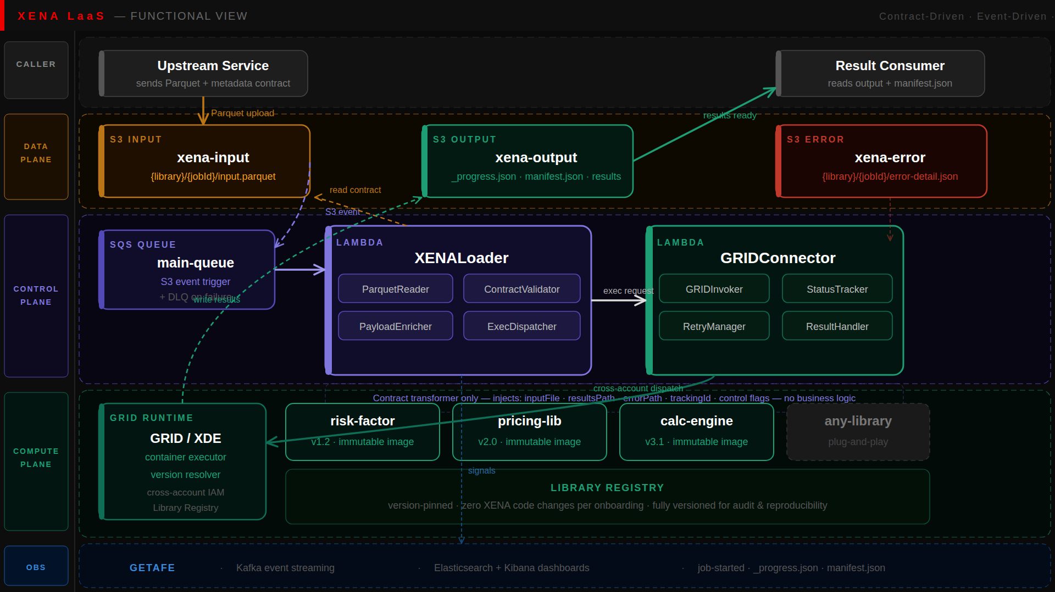
FUNCTIONAL VIEW
Functional Architecture
Three-plane model — Control · Data · Compute

Slide 16
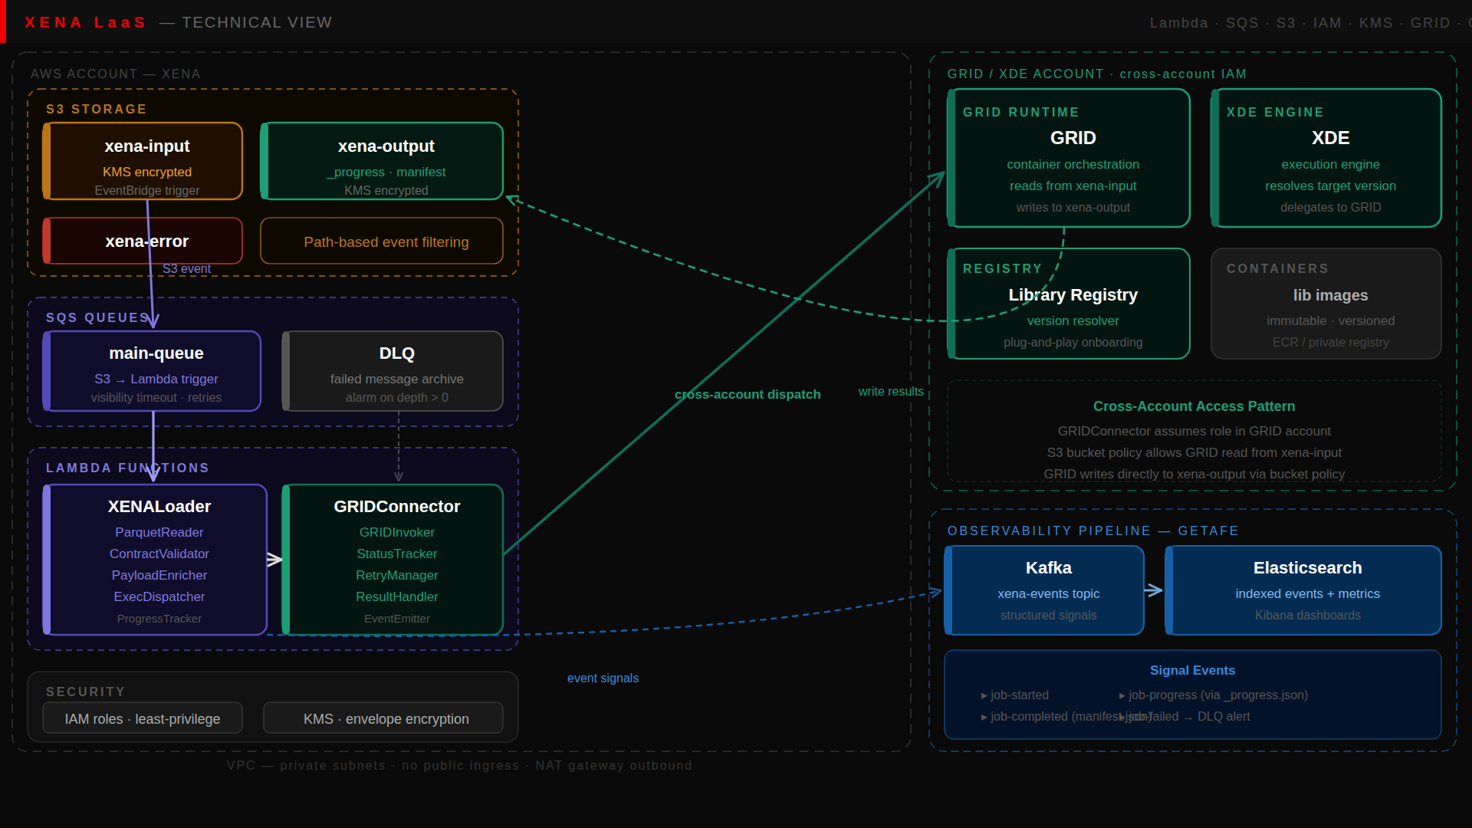
TECHNICAL VIEW
Technical Architecture
Lambda · SQS · S3 · IAM · KMS · GRID · GETAFE

Slide 17
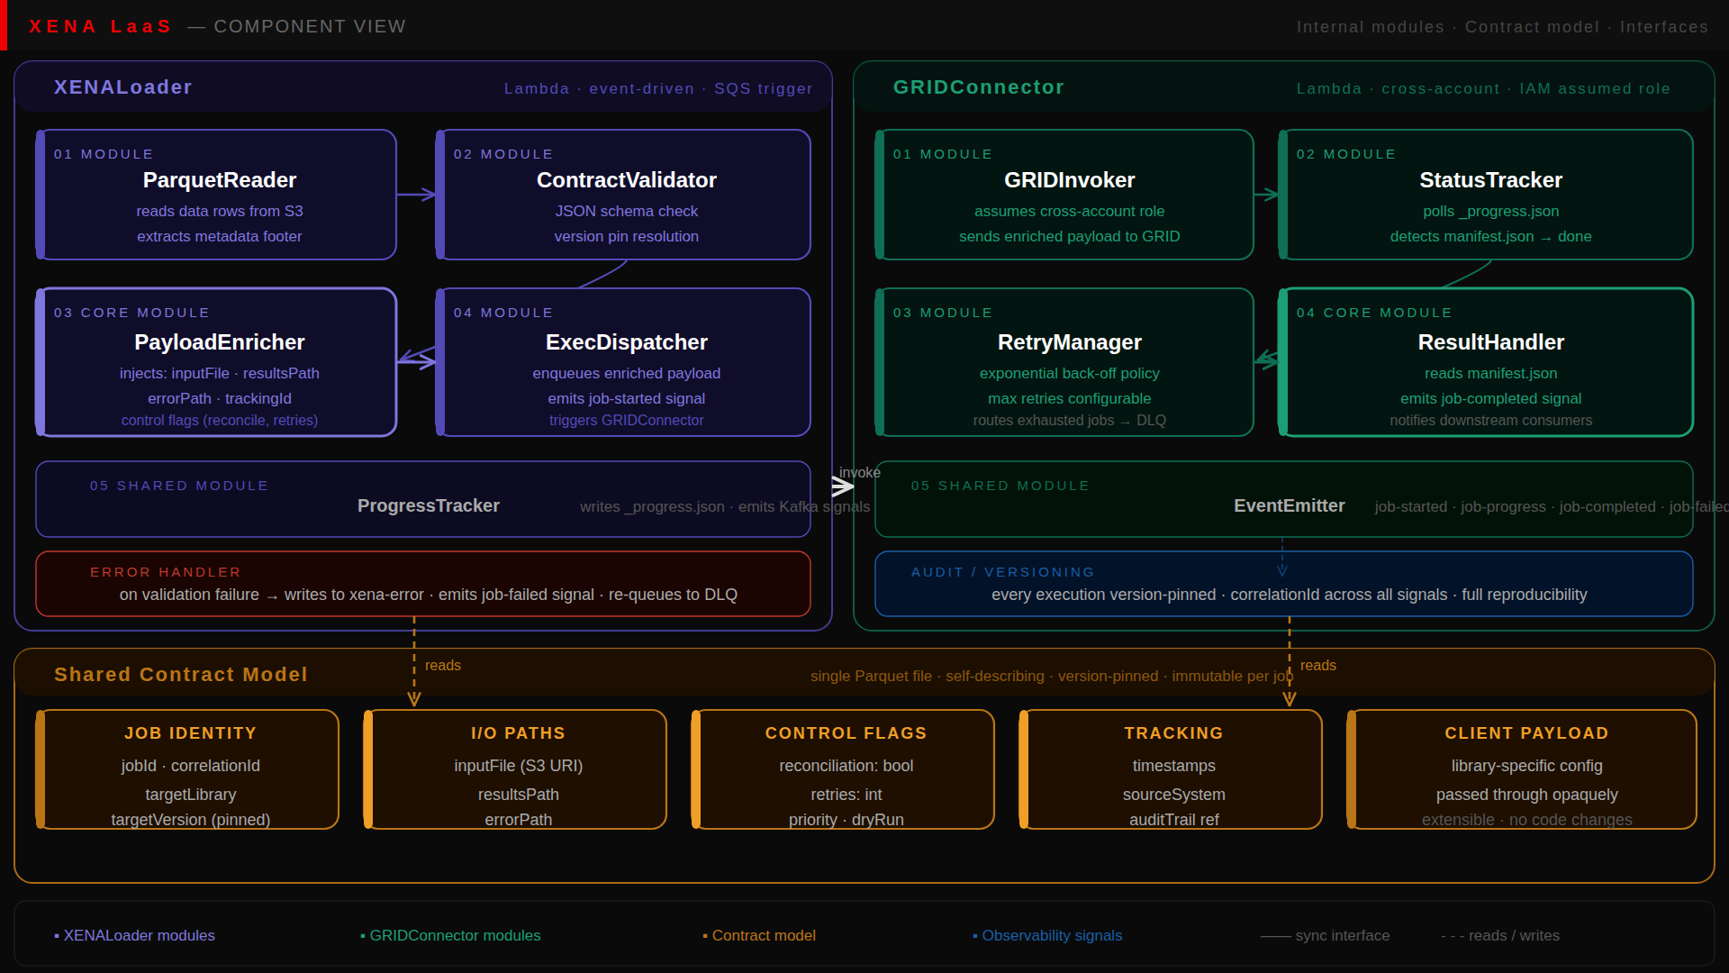
COMPONENT VIEW
Component Architecture
Internal modules · Contract model · Interfaces

